Slide 1
Introduction to Federal Income Tax Law

Slide 2
Lesson Topics
Tax law basics
Types of
Income
Deductions
Credits
Form 1040 and Schedules 1-3
Training materials available

Slide 3
Tax Law Basics
All income is taxable
Unless the law says it is not
No deduction is allowed
Unless the law says it is
No credit is allowed
Unless the law says it is

Slide 4
Tax Law Basics
Gross Income
Minus adjustments
= Adjusted gross Income
Minus deductions
= Taxable Income

Slide 5
Types of Income
Pub 4012 Tab D
Two types of income
Taxable
Earned
Unearned
Nontaxable
Earned
Unearned

Slide 6
Types of Income
Pub 4012 Tab D
Taxable income
Must be reported
Subject to tax
Nontaxable income
May be reportable
Exempt from tax
Notes:
Pub 4012 Tab D Table A Table B examples of both types of income

Slide 7
Types of Income
Examples of earned income: income received from work
Wages
Self-employment
Long term disability payments prior to minimum retirement age
Union strike benefits
Notes:
Must have earned income to qualify for EIC.

Slide 8
Types of Income
Examples of unearned income: income not produced from work
Unemployment compensation
Interest and dividends
Capital gains
Social security benefits
Retirement income
Schedule E rental income
Scholarship income
Alimony
Notes:
Pre 2019 Alimony is considered compensation for the purpose of contributing to an IRA.
2019 decrees or modified decrees stating new rules in effect: Alimony is not considered compensation for the purpose of contributing to an IRA

Slide 9
Types of Deductions
Adjustments and deductions reduce taxable income
Two types
Adjustments to gross income
Itemized or standard deduction
Notes:
Itemized deduction are on Schedule A and can be claimed instead of the standard deduction
TaxSlayer will select the one that yields the lowest tax

Slide 10
Types of Credits
Credits reduce tax liability dollar for dollar
Nonrefundable
Limited to tax liability
Cannot reduce tax liability below $0
Refundable
Can reduce tax liability below $0
Entered in Other Payments section Form 1040

Slide 11
Form 1040 and Related Schedules
Form 1040: Filing status, identity, and dependents
Form 1040: Income, adjustments, and tax liability
Additional income (on Schedule 1)
Additional taxes (on Schedule 2)
Nonrefundable credits, refundable credits, and payments (on Schedule 3)

Slide 12
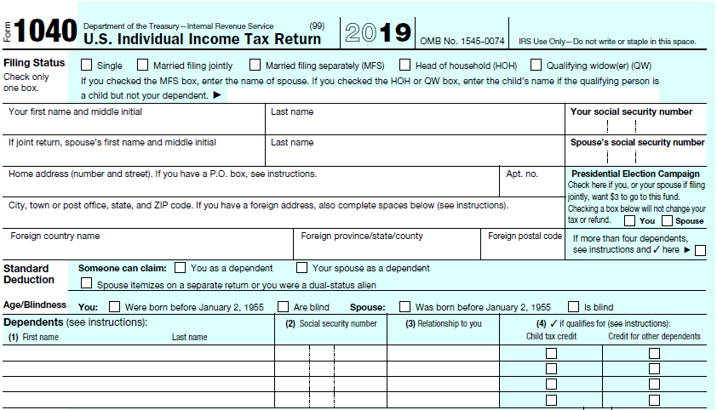
Form 1040, Page 1 top
Filing Status and Identity
Dependents
Notes:
Best if learners have either a hardcopy or electronic version of 1040 to follow along.

Slide 13
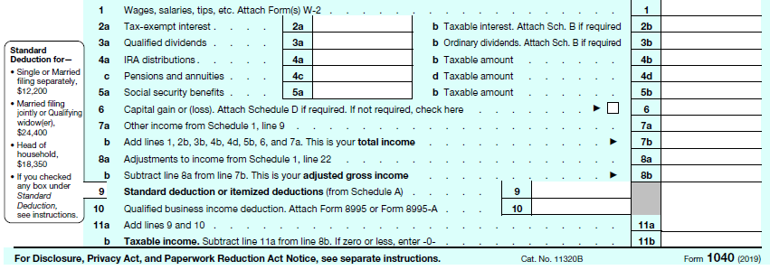
Form 1040, Page 1 bottom
Income and Adjustments
Notes:
Best if learners have either a hardcopy or electronic version of 1040 to follow along.
If taxpayer made a deductible IRA contribution, which line? 8a
If taxpayer has student loan interest deduction, which line? 8a
Which line shows standard or itemized deductions? 9
If taxpayer has a Schedule C business, which line shows qualified business deduction? Line 10

Slide 14
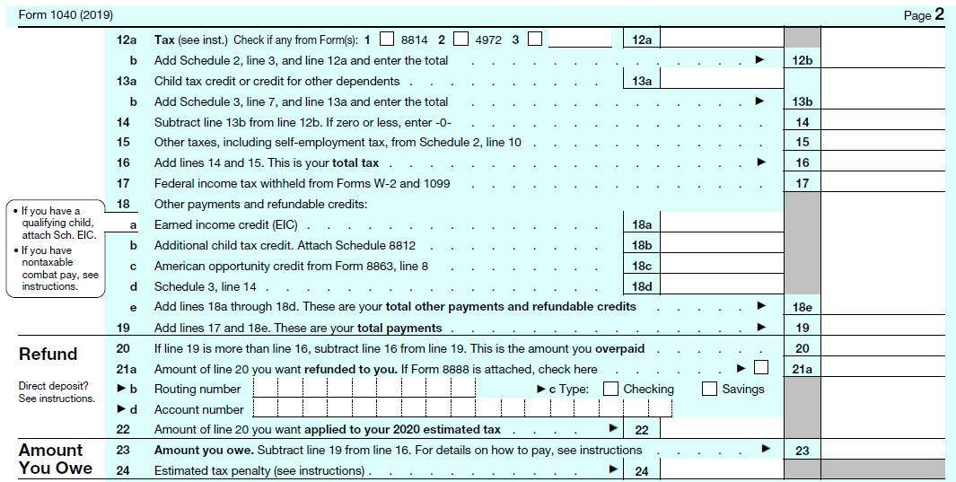
Form 1040, Page 2 top
Tax Liability
Payments and Refundable
Credits
Notes:
If taxpayer has child tax credit or credit for other dependents, which line? 13a
If taxpayer has nonrefundable education credit, which line? 13b
Which line has Federal withholding? 17
If taxpayer has no tax liability, but is getting refundable additional child tax credit, which line? 18b
Which line is Earned Income Credit? 18a

Slide 15
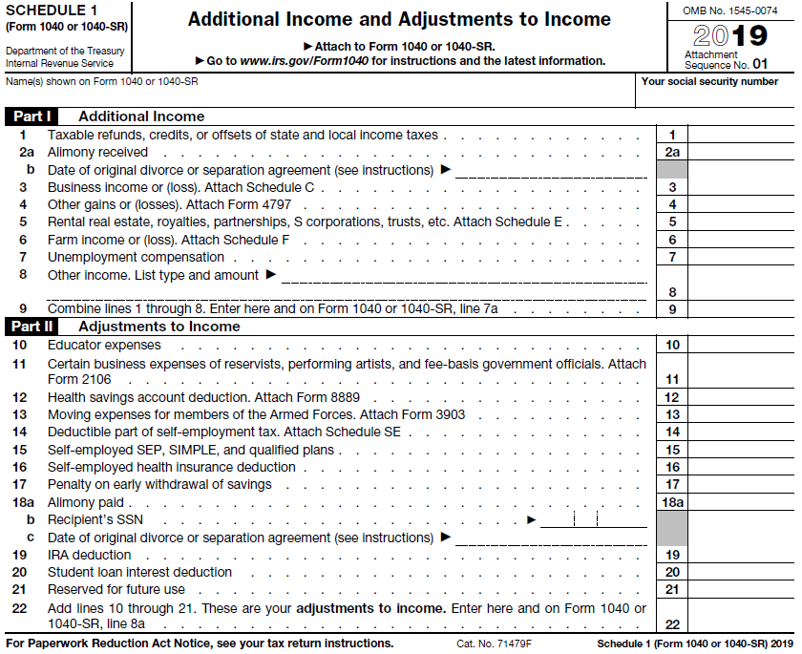
Schedule 1
Additional Income
Adjustments to Income

Slide 16
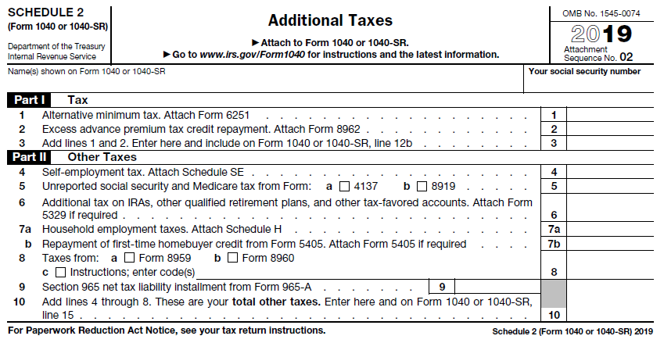
Schedule 2
Tax
Other Taxes

Slide 17
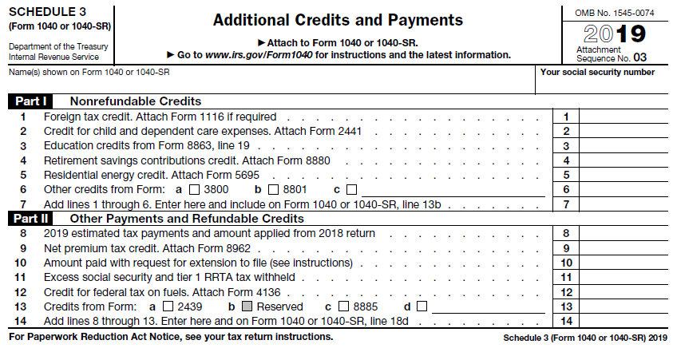
Schedule 3
Nonrefundable credits
Payments and
refundable
credits

Slide 18
Training Materials
IRS Resources
linklearncertification.com
Form 6674 – Certification Test and Retest
Pub 4491 – Training Guide
Pub 17 – Your Federal Income Tax for Individuals
Tax Aide Resources
Pub 4012 – Volunteer Resource Guide (modified)
TaxSlayer Practice Lab – Sections 4 & 6 of HOME page
NTTC Workbook – Practice Exercises
Notes:
Instructor should have learners find each resource as the instructor reviews each one
Counselors must use the modified Pub 4012, which has the modifications for the Tax Aide Program; contains critical updates for Scope and Taxslayer entries
Counselors can use the electronic version of Pub 17 found on irs.gov

Slide 19
NTTC Workbook
Training exercises
Practice exercises
Quizzes
Available in Portal Library and by ordering through Portal

Slide 20
Two Types of Exercises
Training Exercises
Practice Exercises
For Instructor to use in a classroom setting
Contain all the core topics usually encountered on the Advanced Exam
Separate Instructor Guide
For counselors to reinforce/refresh knowledge and skill
For counselors to demonstrate proficiency and meet certification requirements

Slide 21
Volunteer Resource Guide
The Golden Book
Primary reference tool during tax season
Modified NTTC version in Portal Library (Recommended)
Notes:
The 2019 version of the Volunteer Resource Guide will be unbound, 3 – hole punched with a 1” ring
(no binder) and shrink-wrapped. It will be necessary to insert the tabs.

Slide 22
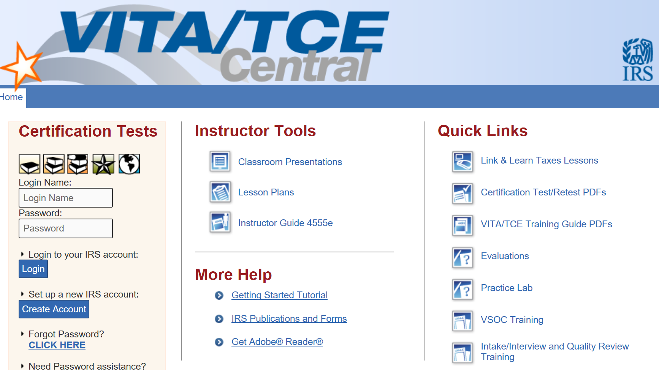
WWW.LINKLEARNCERTIFICATION.COM
Notes:
IRS Web site LinkLearnCertification
Certification Tests--create an account and retain your login/password for future years.
Quick Links include self-study lessons and
Link to Taxslayer Practice Lab—create an account and retain your login/password for future years
Instructor Tools
More Help

Slide 23
VITA/TCE Volunteer Assistor’s Test/Retest
Form 6744 contains all tests
Counselors are required to pass three tests with 80% or better
Volunteer Standards of Conduct
Intake/Interview and Quality Review
Advanced Course
Pay attention to wording on test questions
Notes:
Learners should be instructed if they fail the test the first time, they should review with a mentor or instructor before taking the test again.

Slide 24
Introduction to Income Tax
Questions…
Comments…

